Slide 1
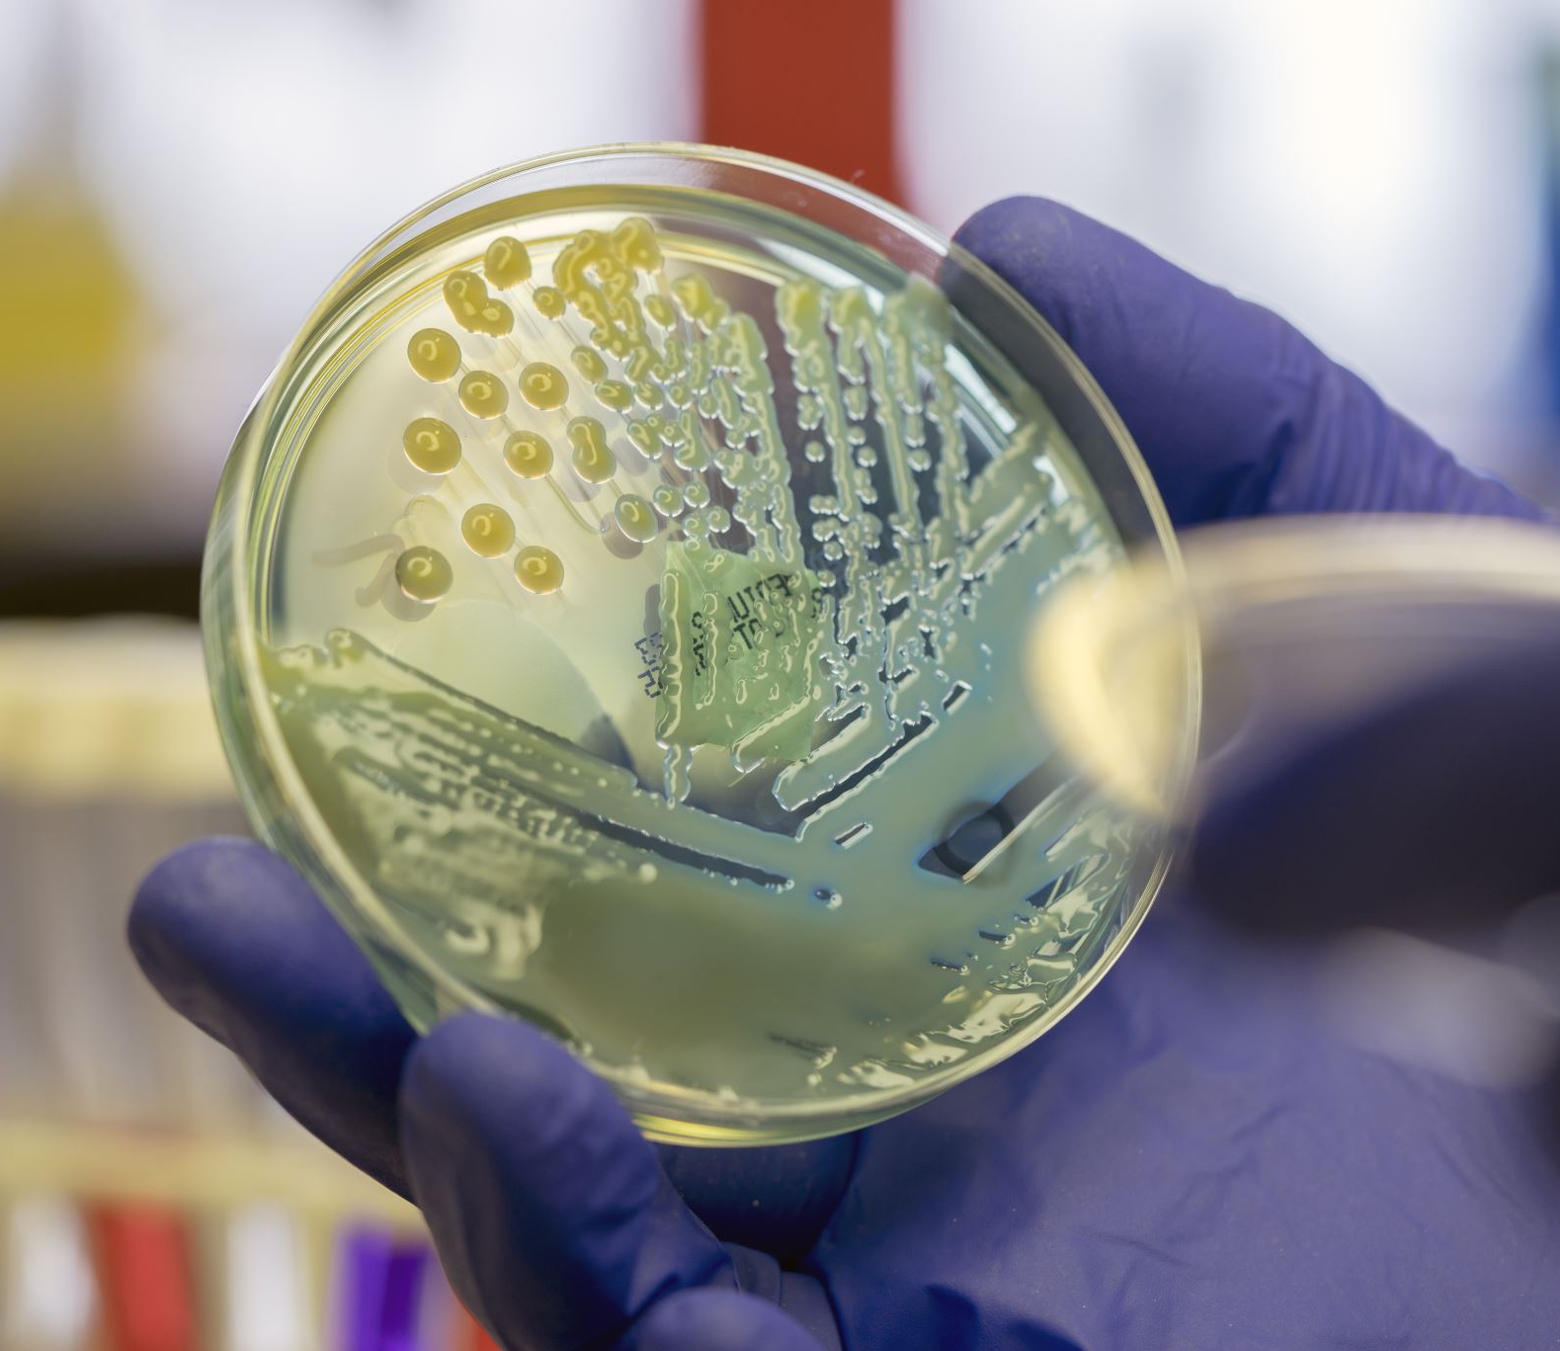
Understanding the Role of Soil Microbes
Laura Decker, President
Prolific Earth Sciences
laura@microbiometer.com

Slide 2
Chemicals and pesticides replace the microbes that provide the plant with nutrients and immune functions.

Slide 3
A healthy soil is deeply on the microbial community for:
Immunity to pathogens
Plant required minerals and nutrients
Digestion of litter
Information about soil conditions that allows the plant to adapt
Creating soil structure-- allowing water holding capacity to almost double
Protection from erosion by increasing soil structure
Sequestering carbon in the dead and alive microbial biomass

Slide 4
Supplying plant nutrients by chemicals stunts the development of healthy roots
Excessive use of chemical fertilizers and pesticides decimate the population of microbes that would supply and deliver nutrients and protect the plant from drought and disease
Nature Education Hodge, A. The plastic plant: root responses to heterogeneous supplies of nutrients. New Phytol 162,
When directly feed nutrients with chemical inputs the plant does not adequately nurture microbes because it has the nutrients it needs
If the plant does not need nitrogen from the microbes it does not deliver the amino acids that those microbes need to survive.
The microbial population in those environments is much lower and quite different from that in a healthy microbial rich system.

Slide 5
Interdependent populations: MB is so interdependent because bacteria have about 1/1000 th DNA that we have Bacteria A can’t grow till bacteria B has broken down cellulose and released its favorite sugar. Bacteria A now produces a vitamin that helps bacteria C etc.
This is how the plate on the right would look 24 hours after inoculation.
This is the plate surface 2 months later. Differ colonies have slowly emerged.

Slide 6
How do microbes build soil structure
Microbes attach themselves to soil particles by secreting sticky substances called EPS (extracellular polymeric substance.)
When microbe dies the sticky substance remains creating soil aggregates and soil carbon

Slide 7
Soil Aggregate Cycle: microbial homes
Aggregates are formed by small roots and fungi and stabilized by microbial exudates
The microbes in aggregates are protected from predators.
Aggregates provide space for oxygen and water to be stored.
Rillig, M., Muller, L. & Lehmann, A. Soil aggregates as massively concurrent evolutionary incubators. ISME J 11, 1943–1948 (2017)

Slide 8
Microbial food security: Carbon Stores
Microbes make the SOC from plant material.
SOC is broken down plant material:
Soluble : Fresh SOC
Stored: Stable SOC
Necromass, debris from dead microbes
Attached to soil minerals or particles.

Slide 9
Microbes increase food security in soil: Food security in the form of SOM is necessary because after the plant or an amendment stimulates microbial population increase, they need to find more food. If they don’t they will die.
Humus
Priming meal

Slide 10
Building a balanced microbial community
There is no formula for this. It depends on your soil, climate, and crop.
Goal is to create optimal conditions for microbes to thrive.
The microbial community can do this given the right foods
Feeding microbes enables the microbial community to start rebuilding cycle

Slide 11
Inputs: Chemical Fertilizers, microbial inputs, and bio stimulants
Chemical fertilizers (NPK)
Expensive and over time depletes natural microbial population
Effective with judicial use
Microbial Inputs (mycorrhizal fungi)
Often issue is that the soil cannot support microbes, not that microbes are in the environment.
Research is on-going but unclear how much microbial populations vary by location.
Bio-Stimulants (Rhyzogreen)
Work because they provide better conditions for microbes to grow.
Perpetuate a system that reduces reliance on expensive chemical fertilizers and pesticides/herbicides.

Slide 12
What is the optimal microbial or fungal to bacteria level? What limits the MB of your soil?
Soil composition
pH: natural and created
Compaction: natural and created
Stores of SOC- Fresh and Stable
Temperature/ Season
Salt and other chemicals: natural and created
Crop history
Water availability

Slide 13
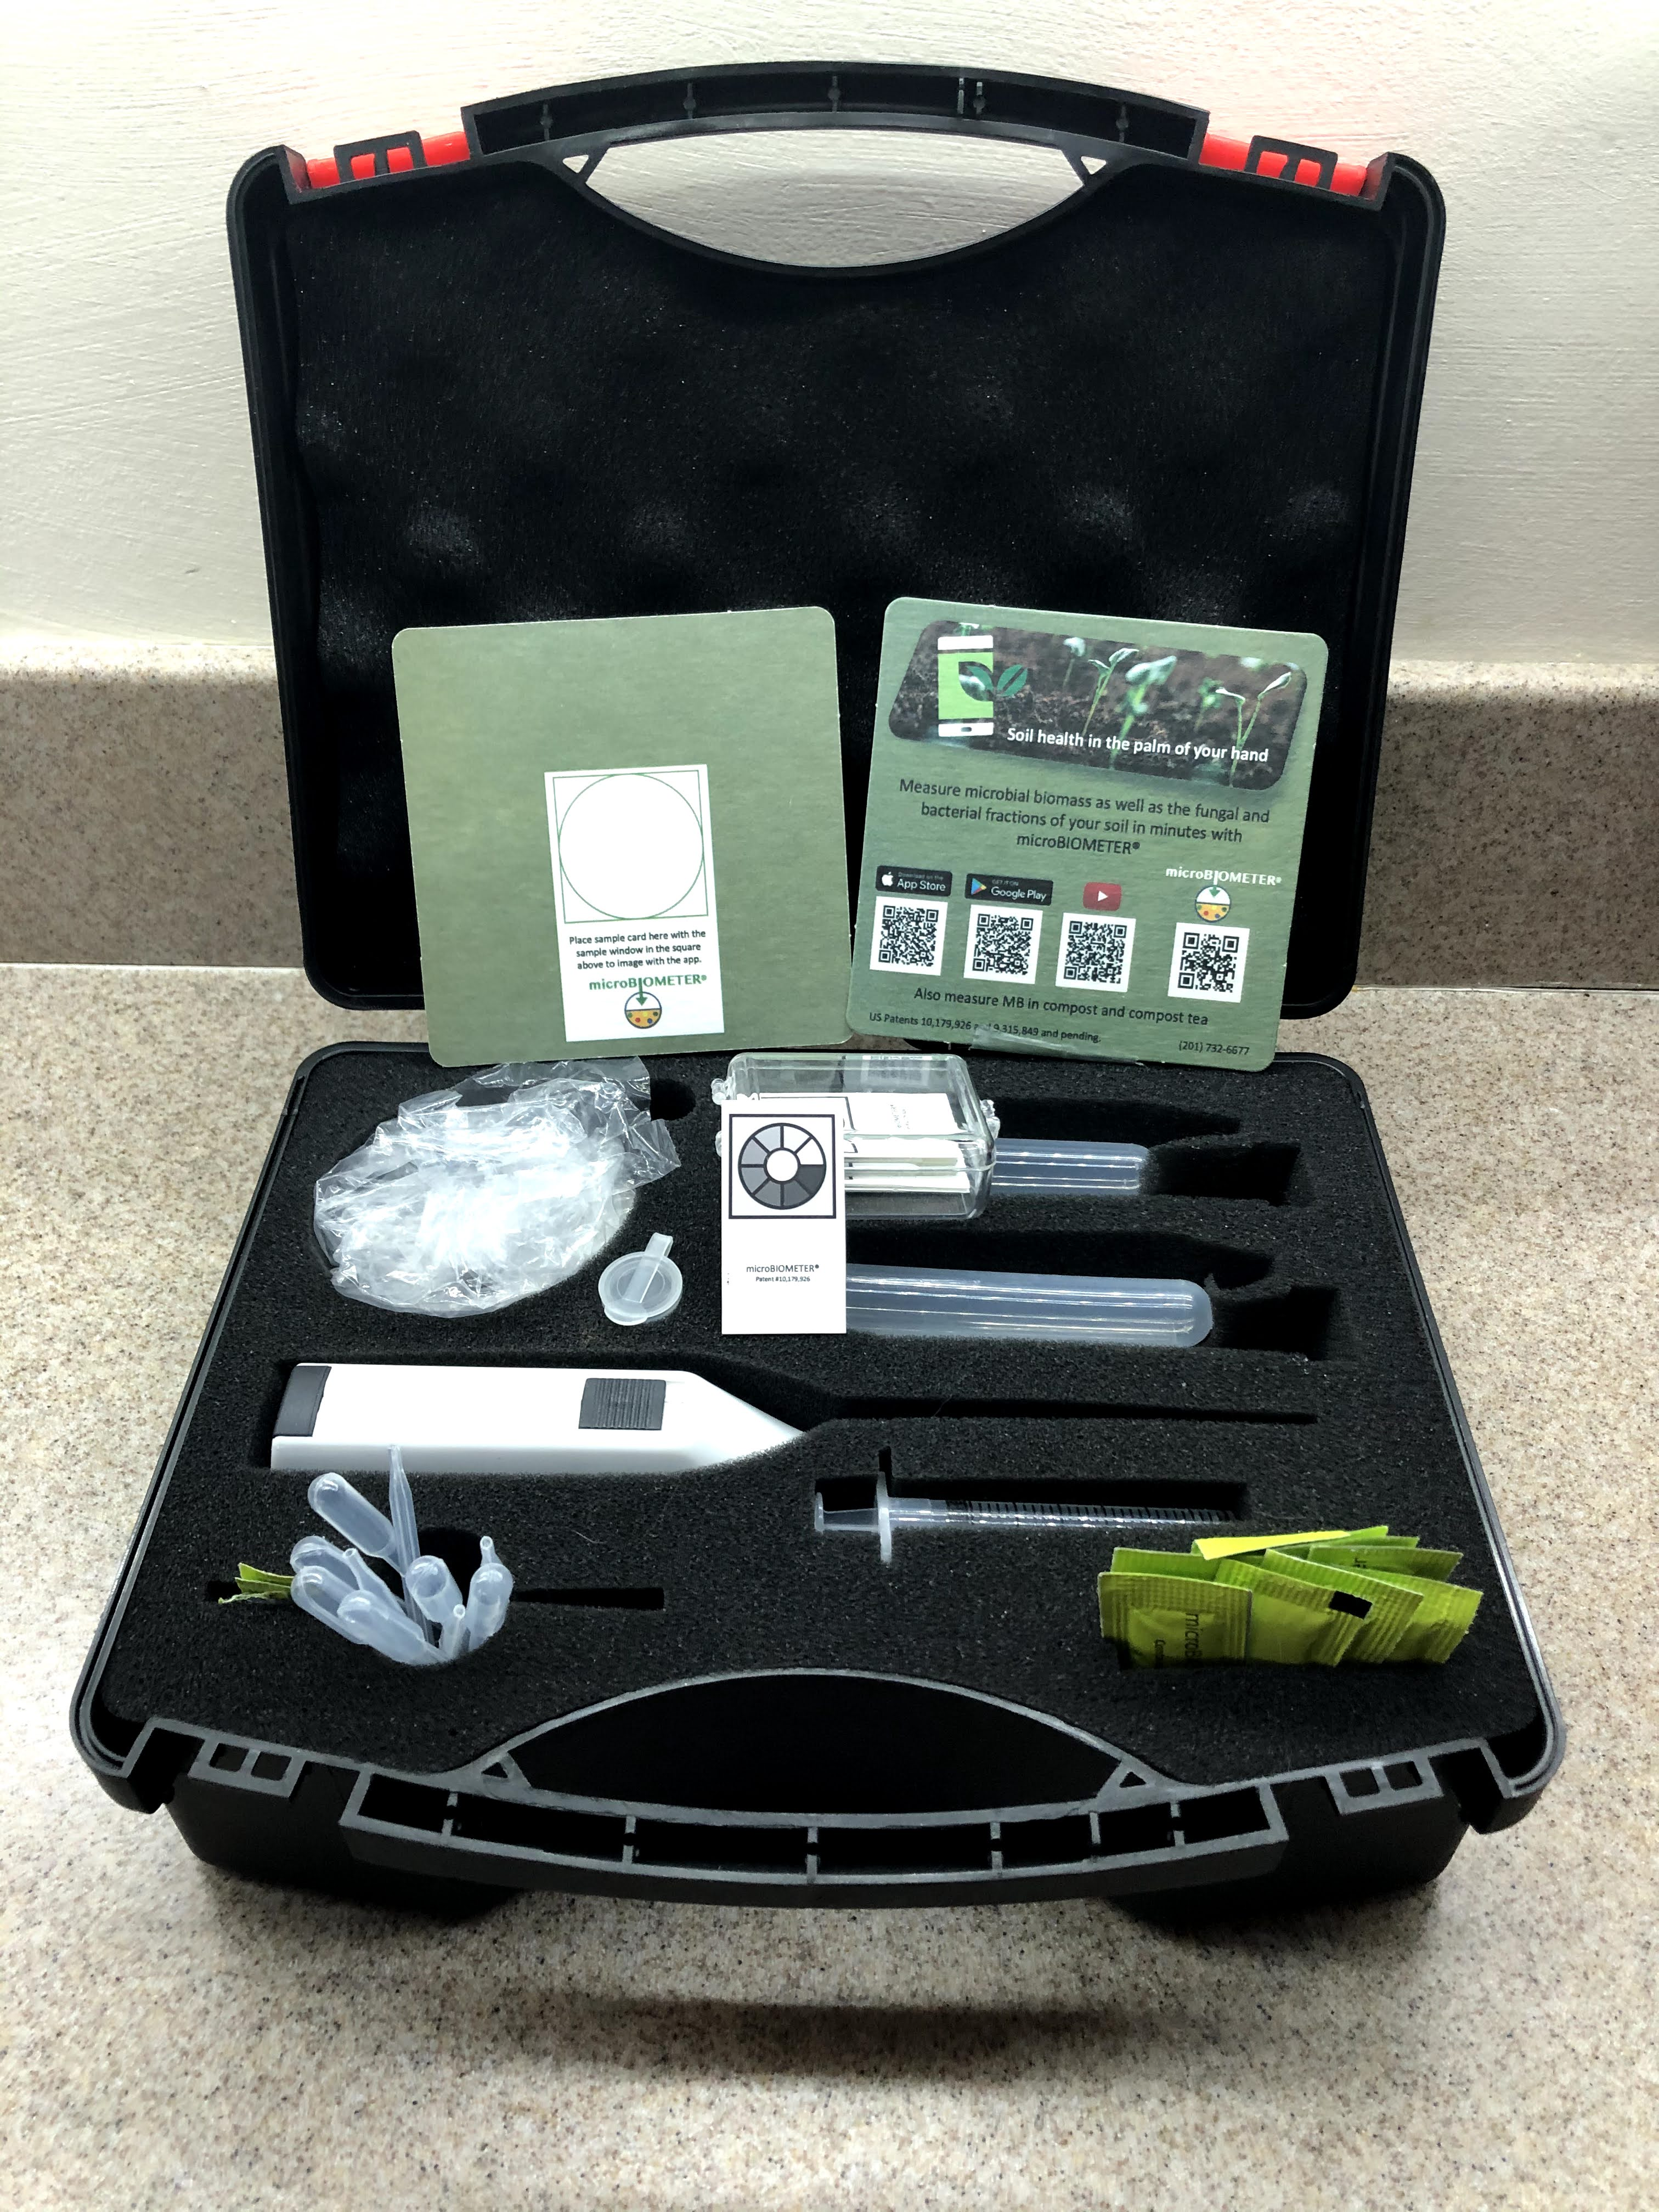
Meet microBIOMETER®
Fast: 20-minute test completed using self contained Kit.
Read by cell phone App and stored in cloud for analysis
No Lab needed: Field portable with no coverage needed
Cost effective- allows for systems testing and analysis

Slide 14
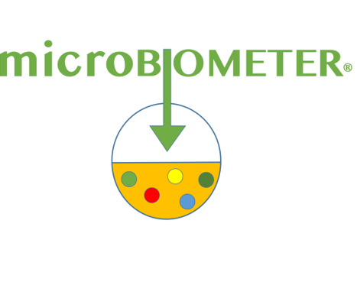
microBIOMETER® Soil Health in the Palm of your Hand Info@microBIOMETER.com www.microbiometer.com

